Slide 1

Internship at the Department Of Social Protection (DSP)
31/1/2017 – 31/07/2017

Slide 2
Introduction to the DSP and company structure
The main services/functions of the DSP are to provide and advise Government and formulate appropriate social protection and social inclusion policies.
It is responsible for the delivery of a range of social insurance and social assistance schemes including provision for unemployment, illness, maternity, caring, widowhood, retirement and old age.
The DSP bases its structure on its continuous Service Delivery Modernisation (SDM) programme, which delivers a high quality service, and also a proactive service to customers.
A series of ICT projects are used to support the SDM programme and improve its main strategic system. (Business Object Model implementation - BOMi)

Slide 3
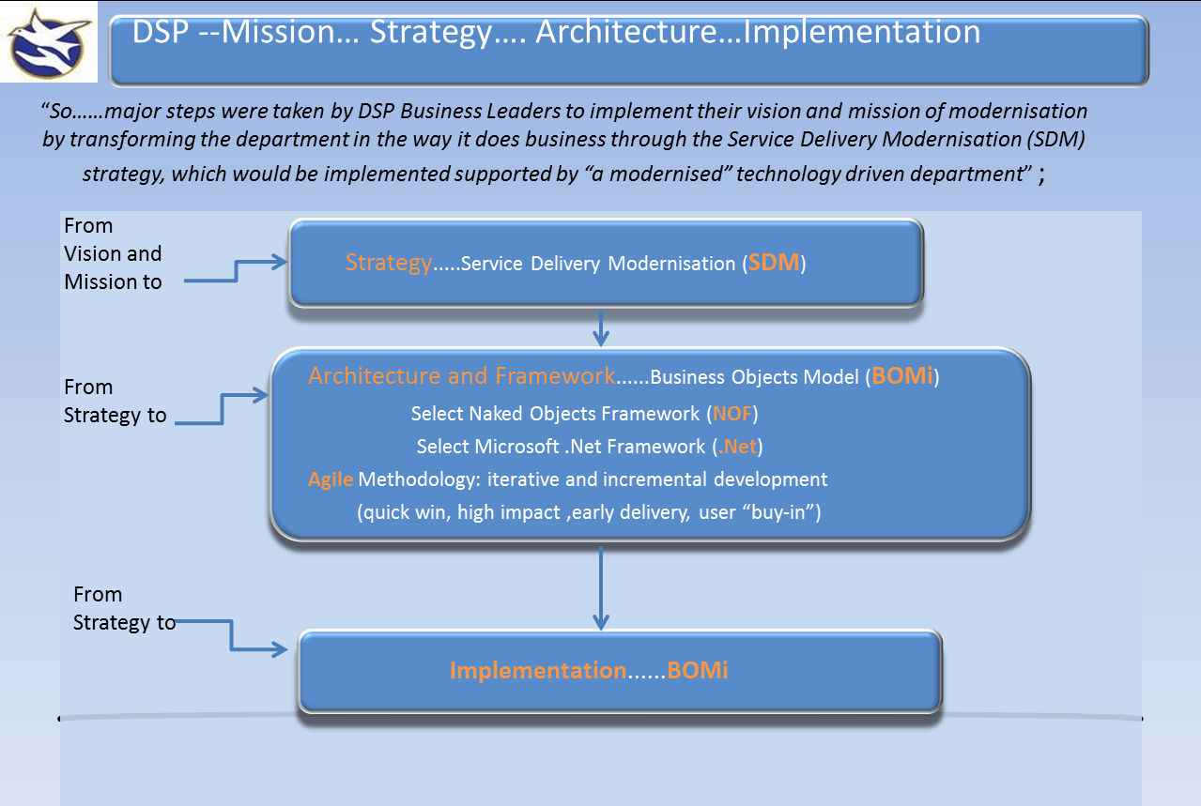
BOMi
Notes:
Naked Objects Framework similar to Model view controller pattern.
- It is just a strong commitment to encapsulation.
- It is a specific interpretation of an object-oriented user interface (OOUI). The user interface shall be 100% automatically created from the definition of the domain objects.
- Creates a fully-functional web application in minutes, without requiring a single line of user interface code to be written.

Slide 4
Training
Training was done in the DSP’s offices in Parnell East building.
Training consisted of learning how to use the DSP’s sites and services and an introduction to all of the Microsoft products/applications that are used.
Also building MVC web applications using the ASP .Net framework in Microsoft Visual Studio 2015.
Agile development and SCRUM methodology.
We also learned about daily stand ups that each team take part in.
Stand ups involve each member of the team communicating to other team members about what they did, what they are doing and what they plan to do. (past, present, future)
Training lasted 2 weeks.
Notes:
Agile Methodology - software development cycle: including planning, requirements analysis, design, coding, unit testing, and acceptance testing.
It is a lightweight software framework that promotes:
- Iterative development throughout the life-cycle of the project.
Close collaboration between the dev team and business side.
Constant communication and tightly knit teams.
SCRUM
Scrum is just one of the many iterative and incremental agile software development method.
In the SCRUM methodology a sprint is the basic unit of development. Each sprint starts with a planning meeting, where the tasks for the sprint are identified and an estimated commitment for the sprint goal is made. A Sprint ends with a review or retrospective meeting where the progress is reviewed and lessons for the next sprint are identified. During each sprint, the team creates finished portions of a product.

Slide 5
Introduction to Release Environment Management (REM) & Central Testing teams
All teams work on a 4 week cycle, at the end of month new updates to live system are introduced.
REM team are responsible for merging projects and building/running projects, scripts, batch jobs, etc.
REM know the current status of automated tests and decide which teams fix broken tests.
Central Testing team’s main focus is on validation of the existing state of the system given new functionality has been introduced to ensure no broken functionality.
The team is constantly being updated on failed and on going automated tests.
The scope of all test cases go across all functional areas within the live system.

Slide 6
REM Continuous Integration (CI) Platform 2.0 team
Where I completed most of my work.
The project involves changing the current company system architecture and developing a new platform for continuous integration.
The new platform will be a git-based development environment with the use of NuGet packages.
It aims to support multiple apps, each of which is made up of multiple components/modules/clusters (more generally: "artifacts").
Each “artifact” resides in its own repository.
When finished the platform will be a much finer grained view of handling the company’s codebases.

Slide 7
Understanding the roles/responsibilities within the REM CI team.
Team was made up of multiple members each of which with a different role.
Two team leaders Dan and Seb who we reported to.
Daily stand ups.
Each week we were assigned new tasks using Trello boards.
Goal was to slowly migrate current live system to new git based platform.

Slide 8
Software and Applications used and Tasks performed.
PowerShell, Jenkins, NuGet , GIT, Visual Studio Code, Visual Studio, Microsoft TFS.
Using git to create repositories for each BOMi “artifact” (usually a sing c# or VB project with supporting tests).
Creating NuGet packages.
Using YAML to write the configuration for each “artifact” - project information, compile configuration, testing configuration and publishing configuration.
Checking C# or VB projects using Visual Studio (if there are issues).
Using PowerShell to run/build/test/create scripts.
Writing scripts using visual studio code and fixing issues with other scripts.
Used Jenkins automation server to build, test, package and publish BOMi artifacts.
Sandcastle script for Documentation.

Slide 9
Conclusion and skills gained
Each team showed me how they work together, develop and communicate in a way that allows workflow to continue without running into major error.
How they use the SDM and BOMi platform to integrate new updates to the live system, how code is checked in and checked out before going onto the live system.
How they incorporate Microsoft’s .NET framework into their system and how they use agile development to easily allow the teams to develop and get jobs done on time.
How to use Git effectively in a team. (branching, merging, etc).
How automation can turn a massive job or process into a much smaller job and increase time efficiency and speed.
Overall I feel from working in the DSP it has benefited me in so many ways that next year I will be able incorporate the skills and techniques I have learned from each team in my modules and 4th year project.

